Slide 1

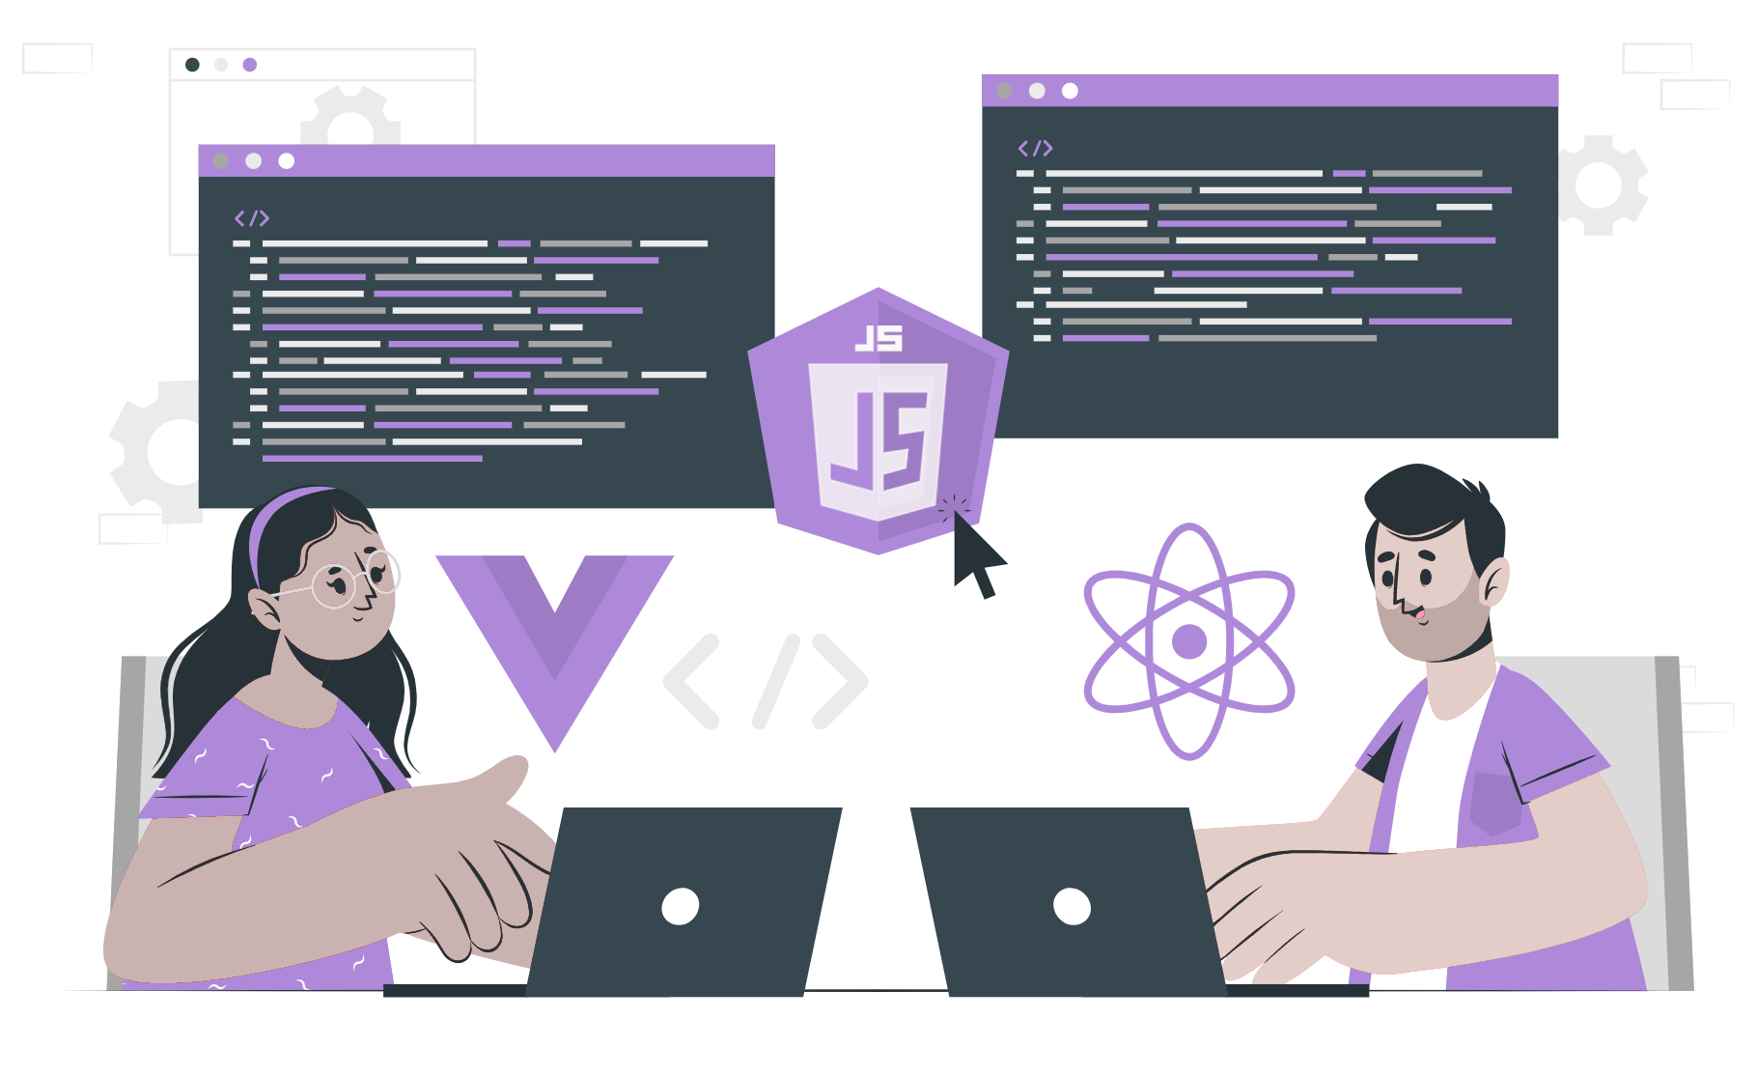
How to create server in Nodejs

Slide 2
Content
HTTP module
Feature of HTTP module
Server with HTTP module

Slide 3
HTTP modules
Hypertext Transport Protocol modules of Nodejs
HTTP modules is the core modules of Nodejs
HTTP modules provide way to create server and handle HTTP request and response.
It exposes various classes, functions and properties to work with HTTP
To use the HTTP server and Client one must require(“node:http”)

Slide 4
Features of HTTP method
Create an HTTP server using `http.createServer()`
Listen to incoming request using the `server.listen()` method
Handle incoming requests and send responses using the `request` and `response` object passed to the server’s request event
Set headers on the response object using `response.setHeader()`
Write data to the response object using `response.write()`
End the response using `response.end()`
Send an HTTP request to a server using `http.request()`
Receive a response from a server using the `response` event of the `http.clientRequest` object returned by `http.request()`

Slide 5
Server with HTTP module
const http = require("node:http"); // getting the http module
const port = 3000; // initializing the port no.
const host = "localhost"; // define the hostname
const server = http.createServer((req, res) => { // create server
res.statusCode = 200; // set to 200 to indicate it is successful
res.setHeader( "Content-type", "text/plain"); // set content type to plain text
res.end("hello world"); // end with ‘hello world’ text return
});
server.listen(port, () => { // list to the define port.
console.log(`Server running at ${host}:${port}`);
});

Slide 6
THANK YOU

